Slide 1
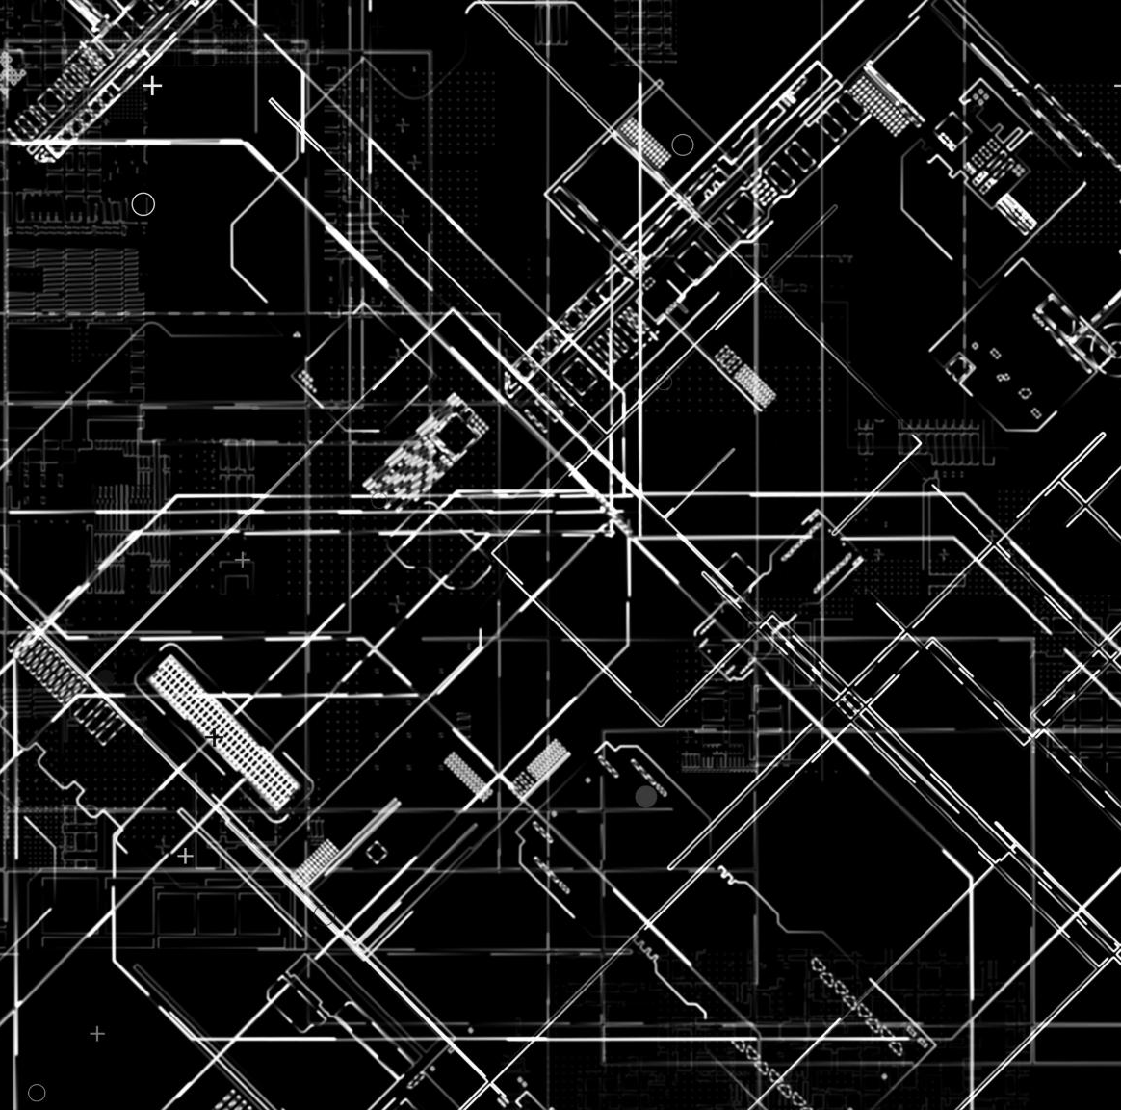
GenAI Integrated Platform Support Environment
TEAM: GenAITects

Slide 2
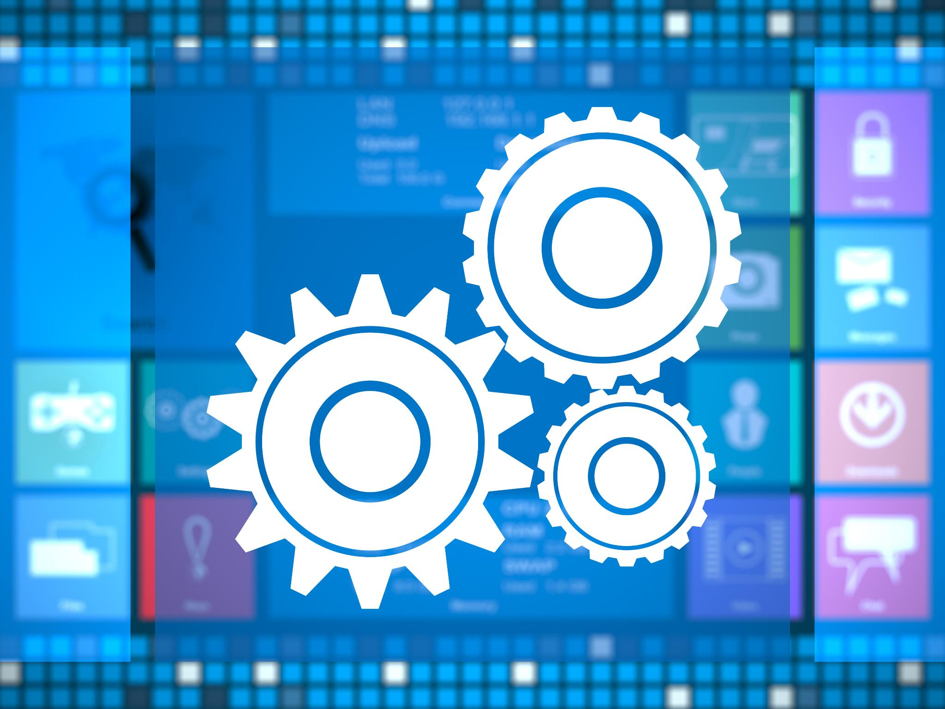
Agenda Items
Designing the GenAI Integrated Platform
Challenges in Development
Outcomes of the Proof of Concept
Notes:
The presentation will start with the design aspects of the GenAI integrated platform, highlighting objectives and user interface considerations. We will then discuss how efficiency and automation are approached, followed by challenges faced during development. Finally, we will review the results and outcomes of our proof of concept.

Slide 3
Designing the GenAI Integrated Platform Environment
Notes:
The design phase is crucial for establishing the foundation of the GenAI integrated platform. Key elements include defining the goals of the platform and ensuring that it meets user needs effectively.

Slide 4
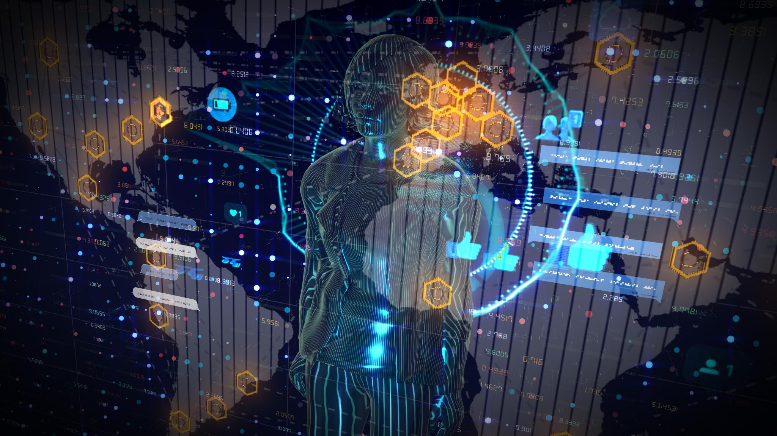
Conceptualization and Objectives
Detail architecture and design
Collecting and producing data for Incident Response
Deployment of Agentic AI features and coordination of agents
Creation of predictive models for resolving incidents
APIs for platform integration
User interface supported by chatbot for platform engineers
Notes:
The conceptualization of the GenAI integrated platform focuses on identifying its main objectives, such as enhancing user experience, improving task efficiency, and integrating advanced AI capabilities. A well-defined purpose guides the development process.

Slide 5
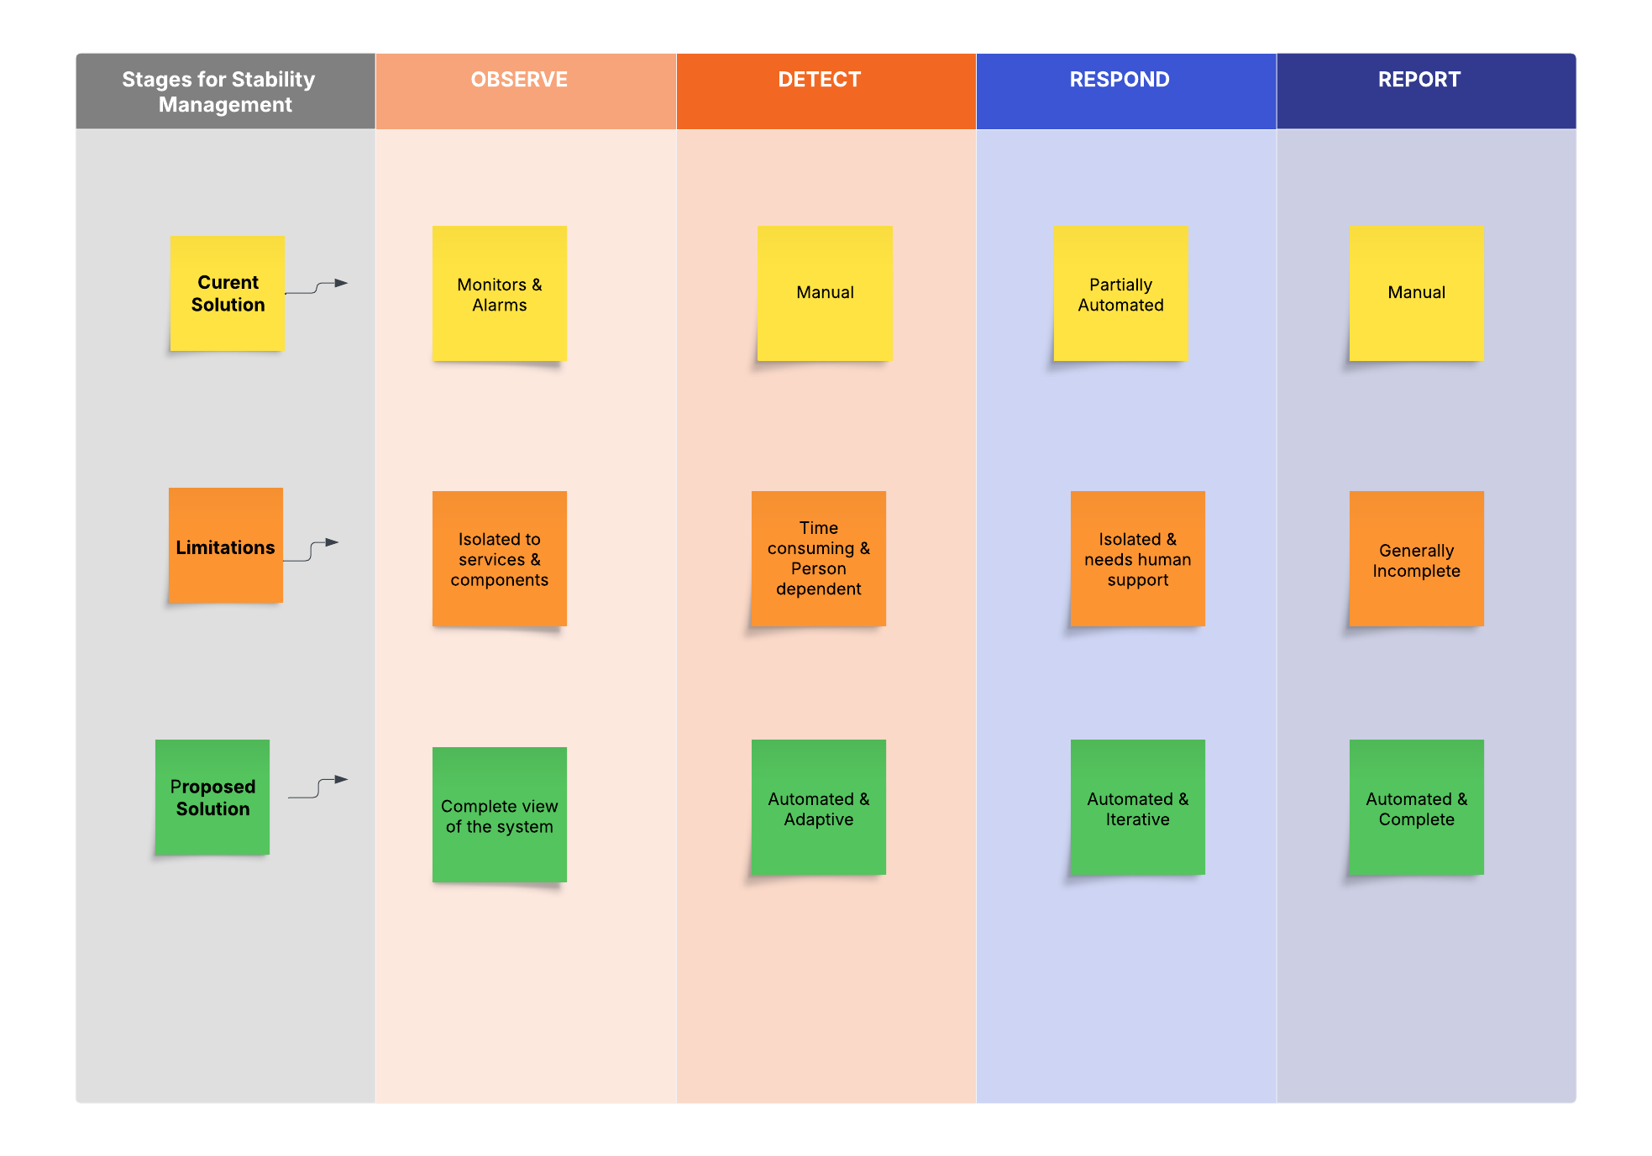
AS-IS to Proposed Solution: Progression
Notes:
The system architecture outlines how different components of the platform interconnect to deliver functionality. This includes data processing layers, user interface modules, and AI engines, all working together seamlessly.

Slide 6
System Architecture and Components
AI-Powered Incident Resolution
• Detects issues before they happen using telemetry and logs
• Automates root cause analysis and applies fixes instantly
• Reduces downtime and speeds up resolution
Smart AI Chatbot
• Provides real-time solutions based on system insights
• Can take direct actions like restarting services or applying fixes
• Works across Slack, Teams, CLI, and ITSM tools
Context-Aware Recommendations
• Analyzes past incidents to suggest the best fix
• Fetches relevant KB articles and historical resolutions
• Continuously learns to improve recommendations
Intelligent Log and Data Extraction
• Pulls only the most relevant logs and metrics
• Reduces noise and simplifies troubleshooting
• Connects with tools like Splunk, Datadog, and cloud platforms
Seamless, Scalable, and Secure
• Works across on-prem, cloud, and hybrid setups
• AI continuously improves with new data
• Secure with access control and audit logging

Slide 7
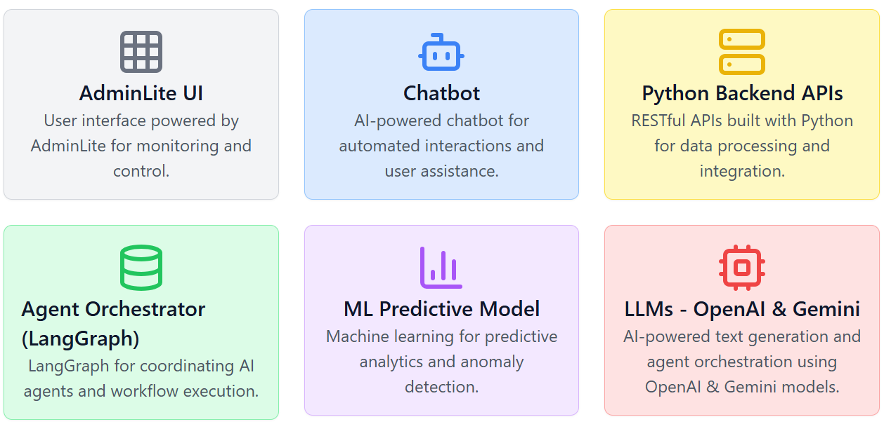
Technical Architecture

Slide 8
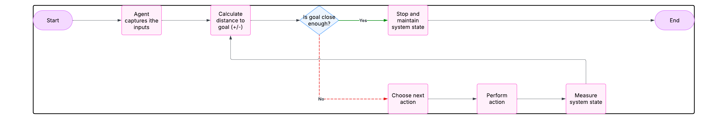
Workflow with Human-in-loop
Proposed: Human-in-the-loop: Incident handling operates within a continuous cycle where AI, enhanced by human input, identifies problems, assesses the system condition, determines the subsequent action, carries out remediation, and evaluates the progress towards resolution.

Slide 9
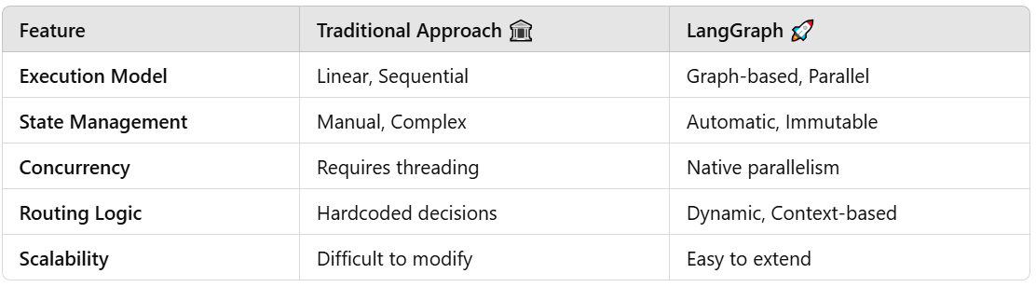
How This Solution Stands Out?
In addition to offering Agentic capabilities through the Unified Portal, the solution employs LangGraph as an orchestrator for Agentic AI.
LangGraph is purpose-built for handling intricate agent workflows within an AI-based system.

Slide 10
Thank You

